Slide 1
B⁺-Trees (Part 2)
COMP171

Slide 2
Review: B+ Tree of order M and of leaf size L
  The root is either a leaf or 2 to M children
  Each (internal) node (except the root) has between ⎡M/2⎤ and M children (at most M chidren, so at most M-1 keys)
  Each leaf has between ⎡L/2⎤ and L keys and corresponding data items
  We assume M=L in most examples.

Slide 3
Deletion
To delete a key target, we find it at a leaf x, and remove it.
Two situations to worry about:
  (1) After deleting target from leaf x, x contains less than ⎡L/2⎤ keys (needs to merge nodes)
  (2) target is a key in some internal node (needs to be replaced, according to our convention)

Slide 4
Roadmap of deletion
Main concern: ‘too small’ to violate the ‘balance’ requirement.
Trivial (leaf is not small)
  A: Trivial (Node is not involved)
  B (situtation 1): Node is present, but only to be updated
C (situation 2): leaf is too small → borrow or merge
    J: borrow from right
    K: borrow from left
    L: merge with right
    M: merge with left
  Trivial (node is not small), only updates
  E: node is too small
      F: root
      G: borrow from right
      H: borrow from left
      I: merge of equals

Slide 5
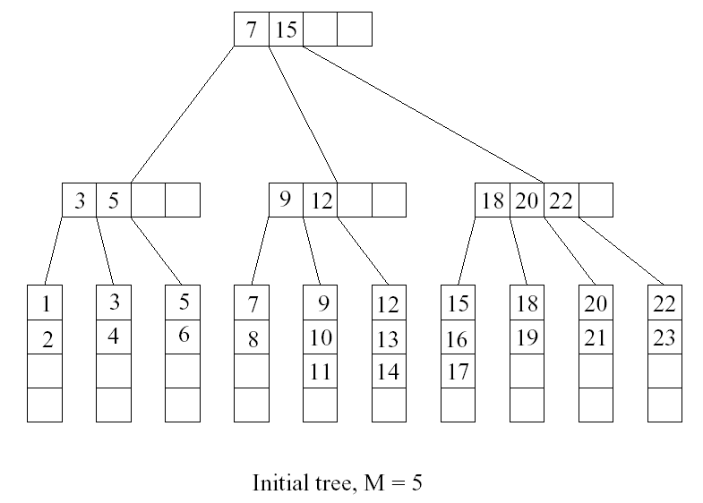
Deletion Example: A
Want to delete 15

Slide 6
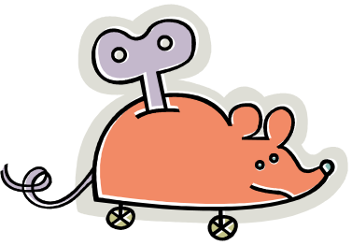
B: Situation 1: ‘trivial’ appearance in a node
target can appear in at most one ancestor y of x as a key (why?)
Node y is seen when we searched down the tree.
After deleting from node x, we can access y directly and replace target by the new smallest key in x

Slide 7
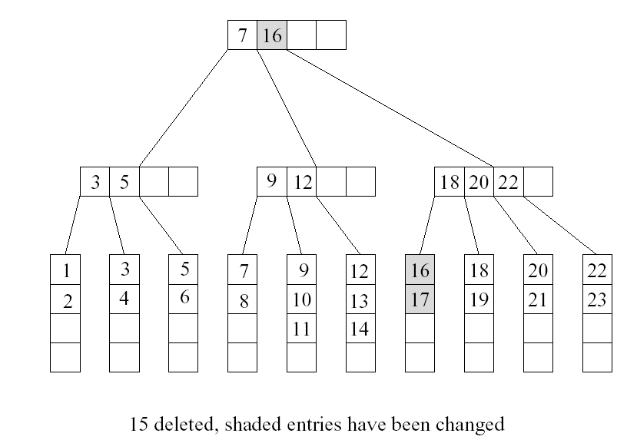
Want to delete 9

Slide 8
C: Situation 2:
Handling Leaves with Too Few Keys
Suppose we delete the record with key target from a leaf.
Let u be the leaf that has ⎡L/2⎤ - 1 keys (too few)
Let v be a sibling of u
Let k be the key in the parent of u and v that separates the pointers to u and v
There are two cases

Slide 9

Possible to ‘borrow’ …
J: Case 1: v contains ⎡L/2⎤+1 or more keys and v is the right sibling of u
  Move the leftmost record from v to u
K: Case 2: v contains ⎡L/2⎤+1 or more keys and v is the left sibling of u
  Move the rightmost record from v to u
Then set the key in parent of u that separates u and v to be the new smallest key in u

Slide 10
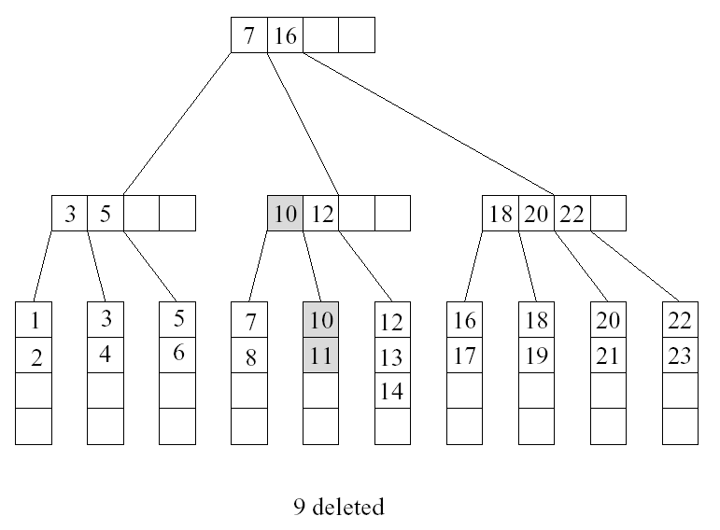
Want to delete 10, situation 1

Slide 11
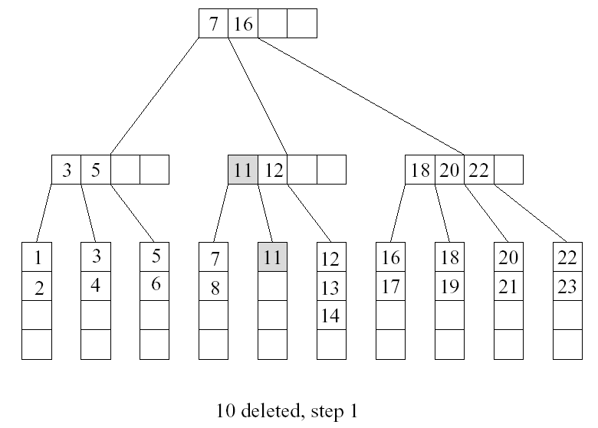
Deletion of 10 also incurs situation 2
u
v

Slide 12
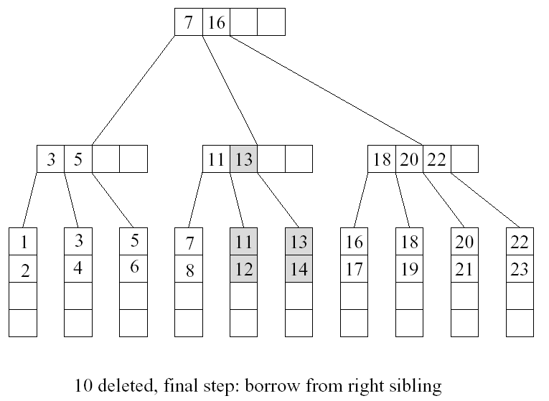

Slide 13

Impossible to ‘borrow’: Merging Two Leaves
If no sibling leaf with ⎡L/2⎤+1 or more keys exists, then merge two leaves.
L: Case 1: Suppose that the right sibling v of u contains exactly ⎡L/2⎤ keys. Merge u and v
  Move the keys in u to v
  Remove the pointer to u at parent
  Delete the separating key between u and v from the parent of u

Slide 14
Merging Two Leaves (Cont’d)
M: Case 2: Suppose that the left sibling v of u contains exactly ⎡L/2⎤ keys. Merge u and v
  Move the keys in u to v
  Remove the pointer to u at parent
  Delete the separating key between u and v from the parent of u

Slide 15
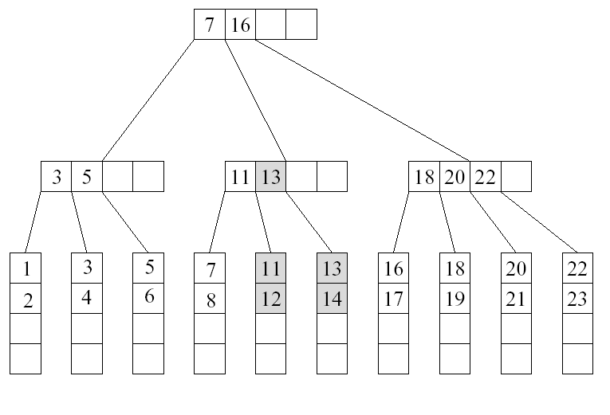
Example
Want to delete 12

Slide 16
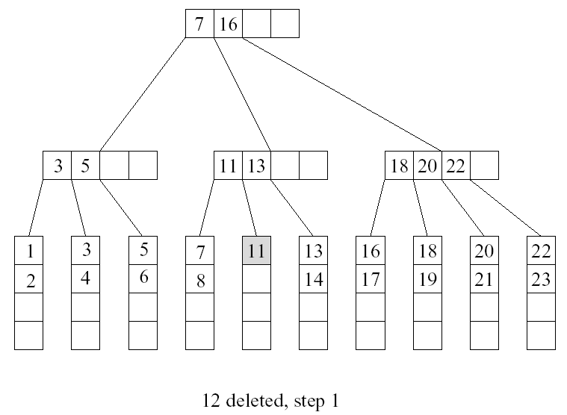
Cont’d
u
v

Slide 17
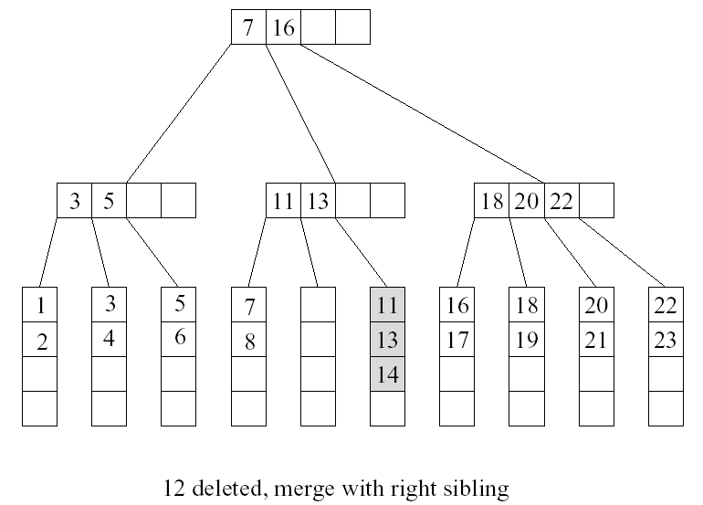
Cont’d

Slide 18
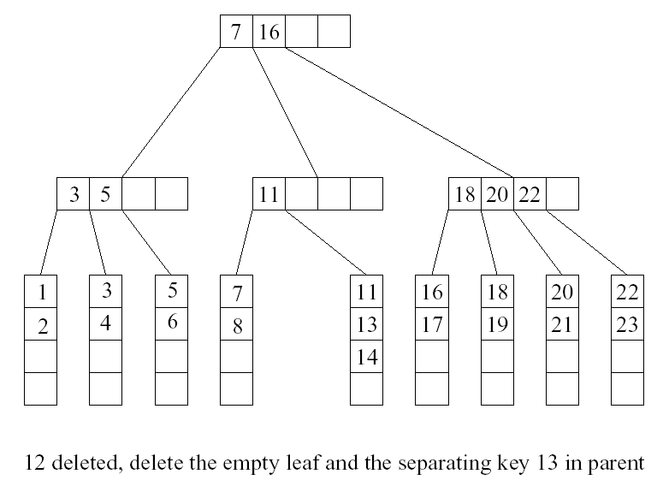
Cont’d
too few keys! …

Slide 19
E: Deleting a Key in an Internal Node
Suppose we remove a key from an internal node u, and u has less than ⎡M/2⎤ -1 keys after that
F: Case 0: u is a root
  If u is empty, then remove u and make its child the new root

Slide 20
G: Case 1: the right sibling v of u has ⎡M/2⎤ keys or more
  Move the separating key between u and v in the parent of u and v down to u
  Make the leftmost child of v the rightmost child of u
  Move the leftmost key in v to become the separating key between u and v in the parent of u and v.
H: Case 2: the left sibling v of u has ⎡M/2⎤ keys or more
  Move the separating key between u and v in the parent of u and v down to u.
  Make the rightmost child of v the leftmost child of u
  Move the rightmost key in v to become the separating key between u and v in the parent of u and v.

Slide 21
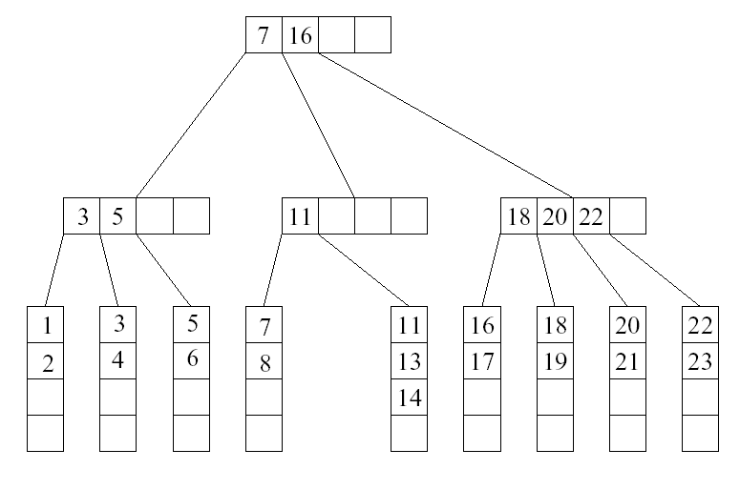
…Continue From Previous Example
case 2
u
v
M=5, a node has 3 to 5 children (that is, 2 to 4 keys).

Slide 22
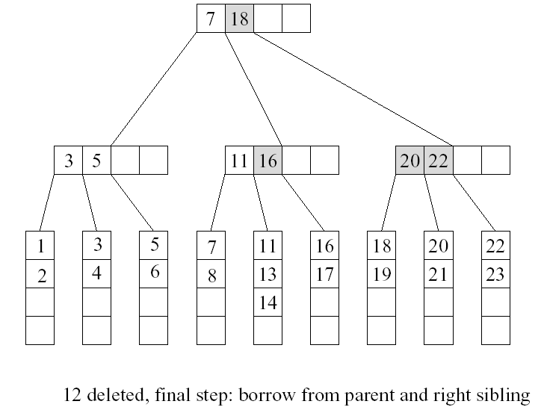
Cont’d

Slide 23
I: Case 3: all sibling v of u contains exactly ⎡M/2⎤ - 1 keys
  Move the separating key between u and v in the parent of u and v down to u
  Move the keys and child pointers in u to v
  Remove the pointer to u at parent.

Slide 24
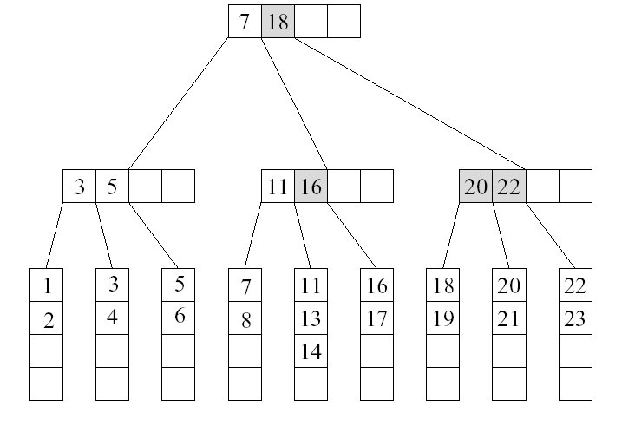
Example
Want to delete 5

Slide 25
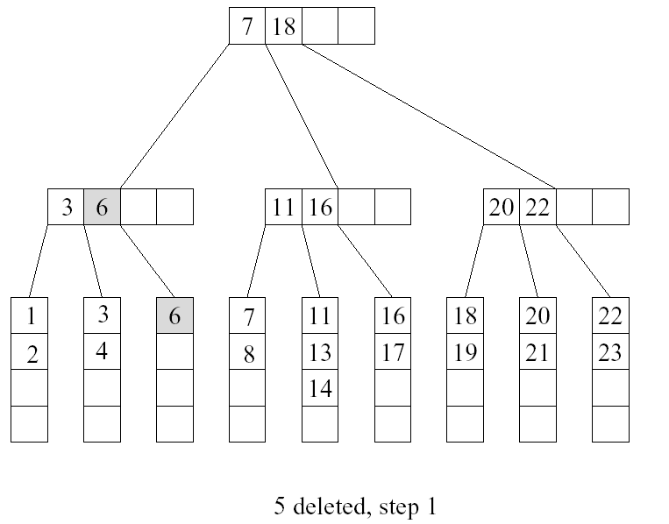
Cont’d
u
v

Slide 26
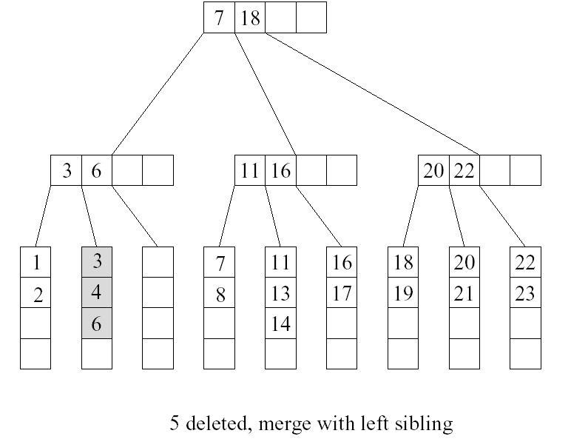
Cont’d

Slide 27
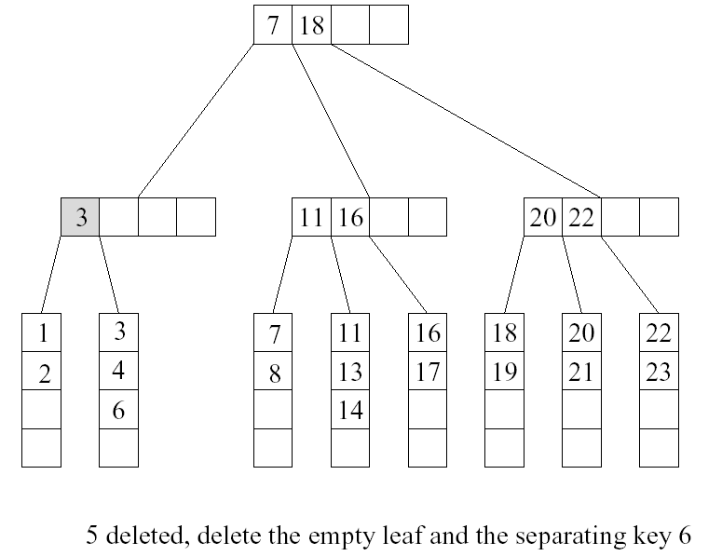
Cont’d
case 3
u
v

Slide 28
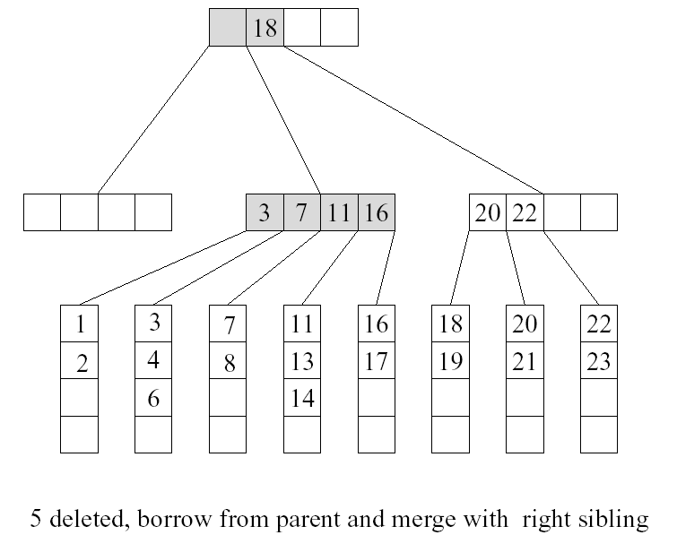
Cont’d

Slide 29
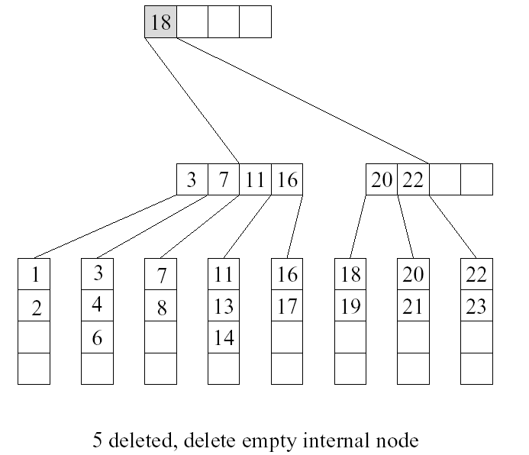
Cont’d

